Slide 1
Agenda
Behavioural Design Patterns
Behavioural Design Patterns
Chain of Responsibility
Command
Interpreter
Iterator
Mediator
Memento
Observer
State
Strategy
Visitor
Template Method

Slide 2
Behavioral Design Patterns (11 Design Patterns)
Deal with the process of communication, managing relationships, and responsibilities between objects.
  Chain of Responsibility
  Command
  Interpreter
  Iterator
  Mediator
  Memento
  Observer
  State
  Strategy
  Visitor
  Template Method

Slide 3
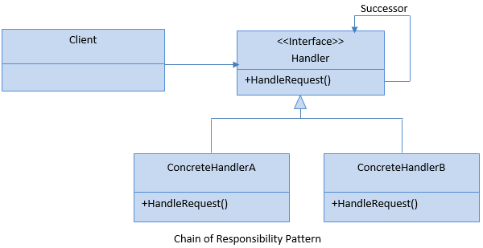
Chain of Responsibility Pattern
Help to perform a multi-steps (a chain of steps) request process.
Decouples sender and receiver based on the type of request.
Notes:
You should have at least 5-6 handlers
Allows you to add handlers dynamically

Slide 4
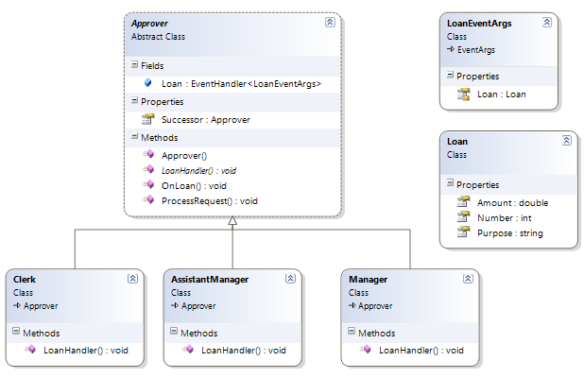
Real Life Example

Slide 5
Chain of Responsibility Pattern Examples
Multi-Steps Request Process
Approval Process
Notes:
The real life example is visiting cards in a company.

Slide 7
DEMO
Chain of Responsibility Pattern Example

Slide 8
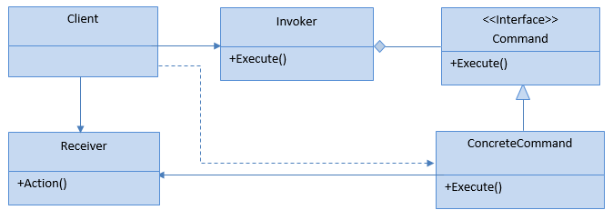
Command Pattern
In this pattern, a request is wrapped under an object as a command and passed to invoker object.
Invoker object pass the command to the appropriate object which can handle it and that object executes the command.
Notes:
You should have at least 5-6 handlers
Allows you to add handlers dynamically

Slide 9
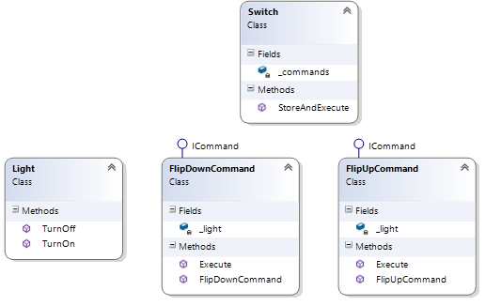
Real Life Example

Slide 10
Command Pattern Examples
Menu systems in applications such as Editor, IDE etc.
Update UI via commands
Auditing and logging of all changes via commands
Notes:
The real life example is visiting cards in a company.

Slide 11
DEMO
Command Pattern Example

Slide 12
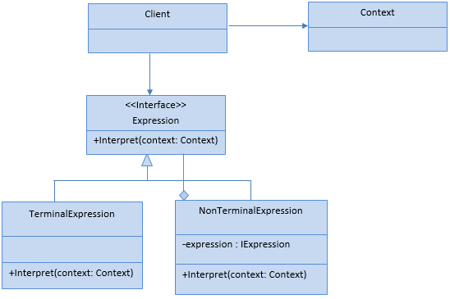
Interpreter Pattern
Evaluates/interprets the instructions (Source Code) written in a language grammar or notation.
Involves implementing an expression interface which tells to interpret a particular context.
Notes:
You should have at least 5-6 handlers
Allows you to add handlers dynamically

Slide 13
Interpreter Pattern Examples
Language Compiler
Language Interpreter/Translator
String/Data Parsing
Notes:
The real life example is visiting cards in a company.

Slide 14
DEMO
Interpreter Pattern Example

Slide 15
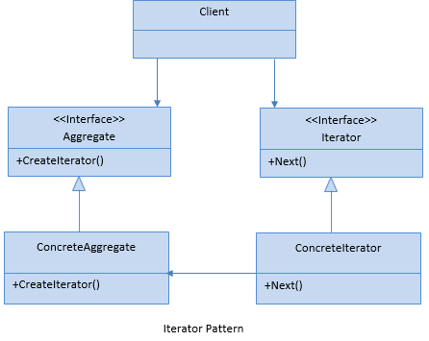
Iterator Pattern
Provides a way to access the elements from a collection in a sequential manner without exposing its underlying structure.
Read-only access and no access to inner collection.
Notes:
You should have at least 5-6 handlers
Allows you to add handlers dynamically

Slide 17
Iterator Pattern Examples
Collection Iteration
Collection Elements Ordering (Asc, Desc)
Notes:
The real life example is visiting cards in a company.

Slide 18
DEMO
Iterator Pattern Example

Slide 19
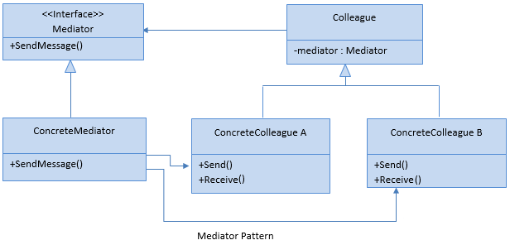
Mediator Pattern
Allows multiple objects to communicate with each others without knowing each other structure.
Defines an object which encapsulates how the objects will interact with each other and supports easy maintainability of the code by loose coupling.
Notes:
Air traffic controller is a great example of mediator pattern where the airport control room works as a mediator for communication between different flights. Mediator works as a router between objects and it can have it’s own logic to provide way of communication.

Slide 20
Mediator Pattern Examples
Messaging
Chat
Notes:
The real life example is visiting cards in a company.

Slide 21
DEMO
Mediator Pattern Example

Slide 22
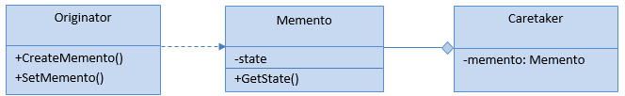
Memento Pattern
Used to capture the current state of an object and store it in such a manner that it can be restored at a later time without breaking the rules of encapsulation.
Notes:
Air traffic controller is a great example of mediator pattern where the airport control room works as a mediator for communication between different flights. Mediator works as a router between objects and it can have it’s own logic to provide way of communication.

Slide 23
Memento Pattern Examples
Undo Operation
Transaction Rollback

Slide 24
DEMO
Memento Pattern Example

Slide 25
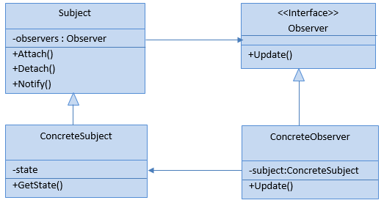
Observer Pattern
Allows a single object, known as the subject, to publish its state changes to other observer objects that depend upon the subject.
Useful when there is a one-to-many relationship between objects where if one object is modified, its dependent objects are to be notified automatically.
Notes:
Air traffic controller is a great example of mediator pattern where the airport control room works as a mediator for communication between different flights. Mediator works as a router between objects and it can have it’s own logic to provide way of communication.

Slide 26
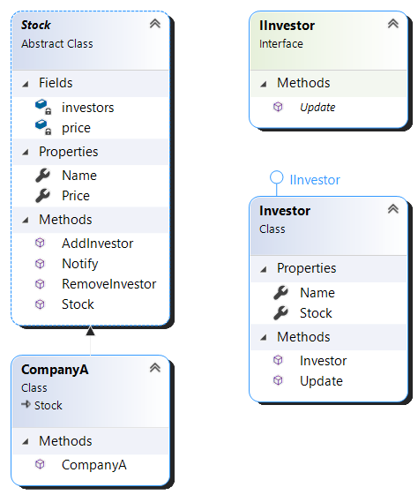
Observer Pattern Examples
Send notification about state change to :
  Followers
  Subscribers
Notes:
https://howtodoinjava.com/design-patterns/behavioral/observer-design-pattern/

Slide 27
DEMO
Observer Pattern Example

Slide 28
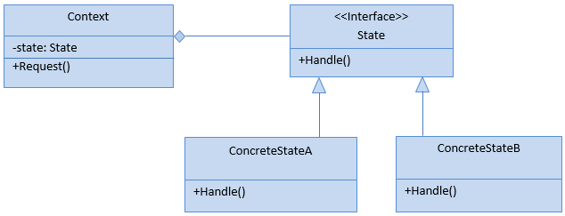
State Pattern
Used to alter the behavior of an object when it’s internal state changes.
Here, an object is created which represent various states and a context object whose behavior varies as its state object changes.
Notes:
Similar to State Machine

Slide 29
State Pattern Examples
Task States: ToDo, Doing, Done
Validation States: Invalid, Valid
A Machine (Printer) States: Ready, Printing, Done
Jobs/Schedulers: Start, Running, Stop

Slide 30
DEMO
State Pattern Example

Slide 31
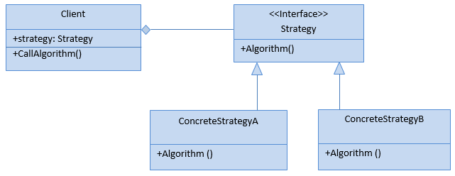
Strategy Pattern
Define a family of algorithms, encapsulate each one, and make them interchangeable.
Allows a client to choose an algorithm from a family of algorithms at run-time and gives it a simple way to access it.

Slide 32
Strategy Pattern Examples
Discount Strategy
Payment Strategy
Notes:
Multiple Strategy for Going to office.
Now client will select one
Go via Car
Go via Bike
Go via bus
Go via train

Slide 33
DEMO
Strategy Pattern Example

Slide 34
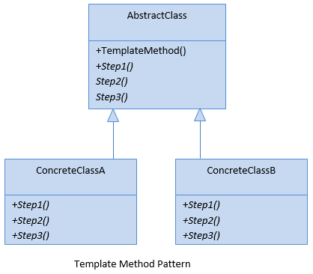
Template Method Pattern
Used to define the basic steps of an algorithm and allow the implementation of the individual steps to be changed.
Looks similar to the strategy design pattern. But its change the parts of an algorithm rather than replacing an entire algorithm.
Notes:
An abstract class as a template with necessary functionalities.

Slide 35
Template Method Pattern Examples
Abstract Classes with default functionality and few methods to implement like :
  A report template
  A certificate template

Slide 36
DEMO
Template Method Pattern Example

Slide 37
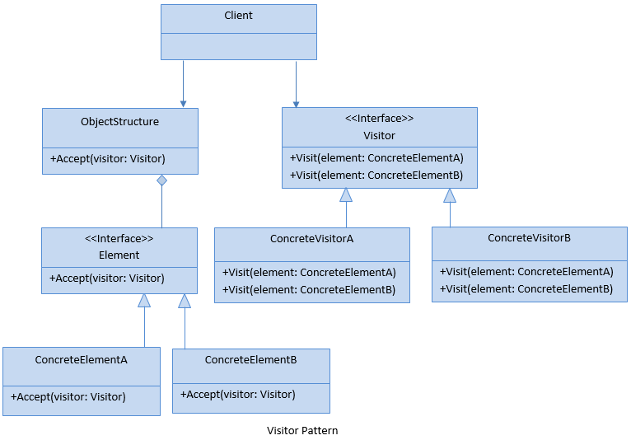
Visitor Pattern
Used to create and perform new operations on to a set of objects without changing the object structure or classes.
Enables loose coupling and addition of new operations without changing the existing structure.
Notes:
Enables loose coupling and addition of new operations without changing the existing structure.

Slide 38
Visitor Pattern Examples
Add Functions to an object Dynamically
Separate Object from Functions
a
=
b
Notes:
Visitor Design Pattern in Java - JournalDev

Slide 39
DEMO
Visitor Pattern Example

